Slide 1
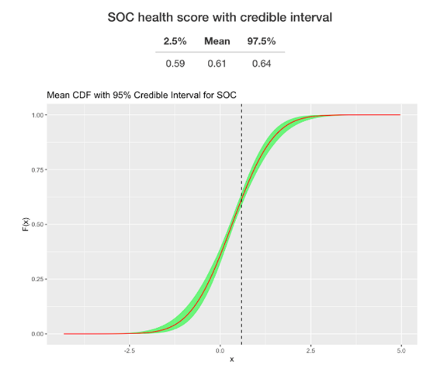
SHAPE Curves - Why
Soil Health Assessment Protocol and Evaluation
Soil health is measured with dynamic soil properties (DSPs), soil properties that change with land use and management
SHAPE curves are an interpretation of DSPs/soil health indicators developed by ARS, NRCS and University of Missouri scientists (Nunes et al; in press).
Soil organic carbon was selected for the first SHAPE curve as it is a key indicator of soil health, reflecting multiple soil functions and ecosystem services.
This is a screenshot from an early implementation of the SHAPE curve and score based on user inputs. The DSP Hub will automate SHAPE scores for soil organic carbon values input from various data sources.

Slide 2
SHAPE Curves - How
Soil Health Assessment Protocol and Evaluation
A SHAPE Curve is developed for groups of similar soils using:
Existing soil organic carbon data
Climate data
Soil survey information
A “SHAPE Score” between 0 and 1 is assigned for each input DSP
The score allows robust statistical analysis on the impacts of soil health adoption for many kinds of soils, land uses and regions
This is a screenshot from an early implementation of the SHAPE curve and score based on user inputs. The DSP Hub will automate SHAPE scores for soil organic carbon values input from various data sources.

